Slide 1


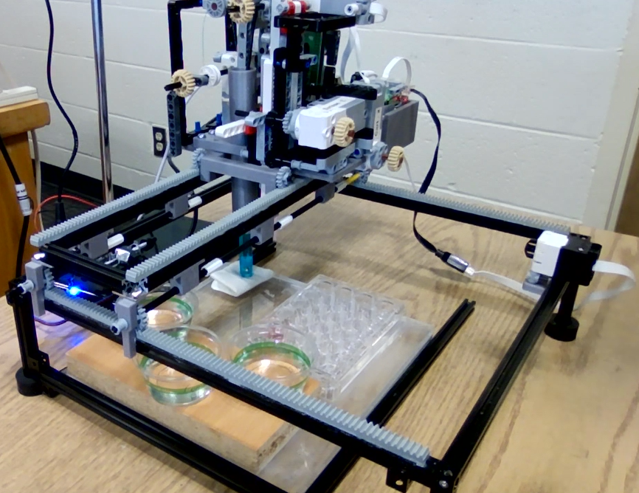
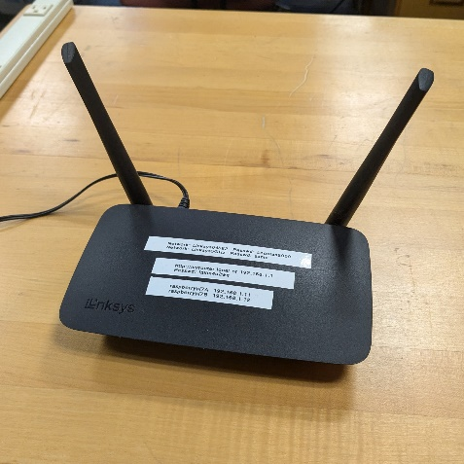
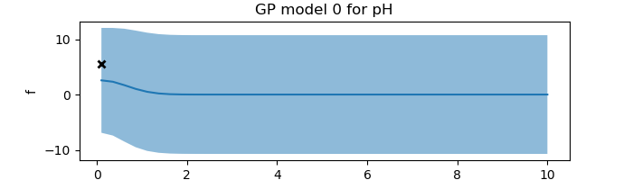
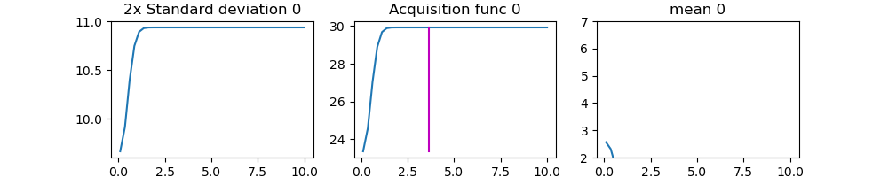
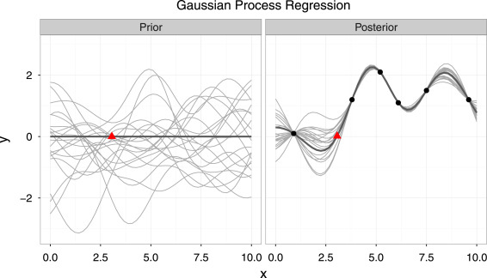
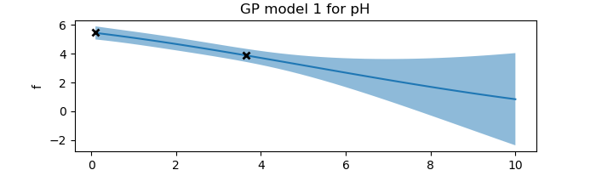
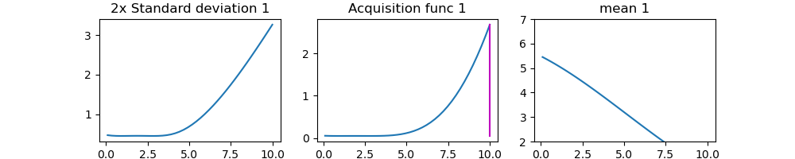
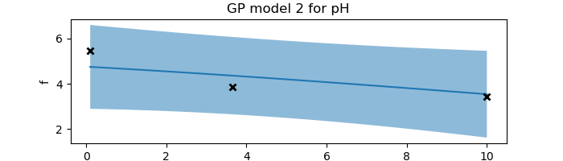
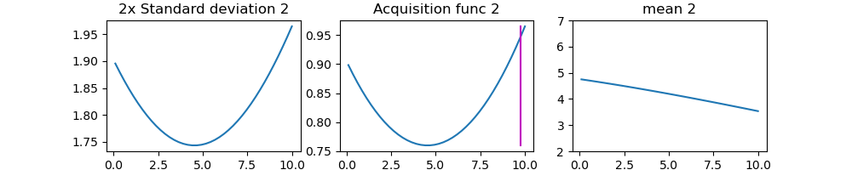
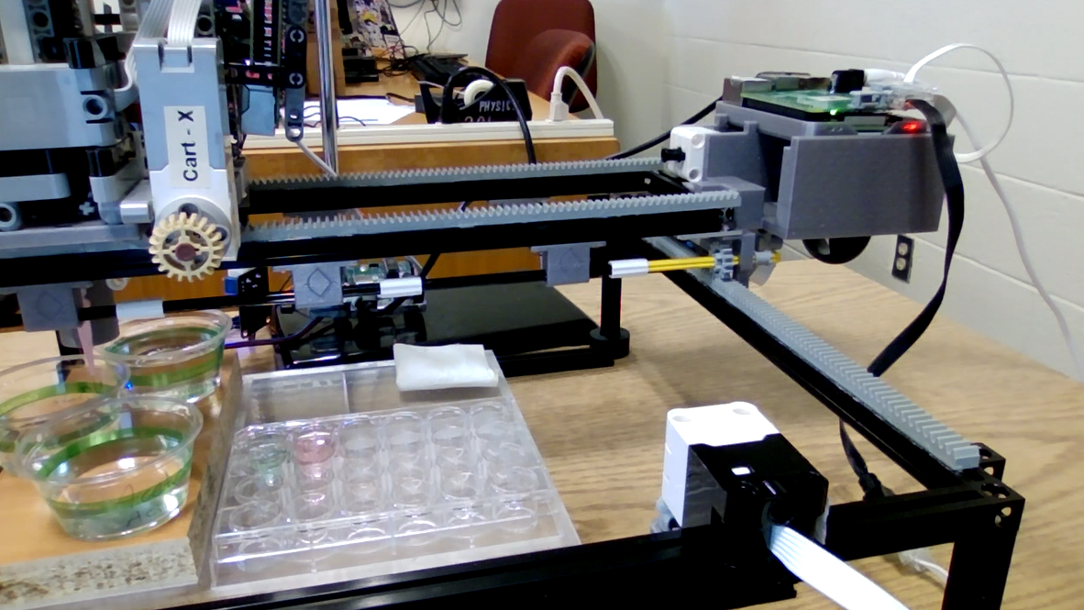
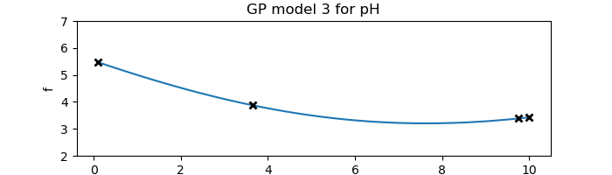
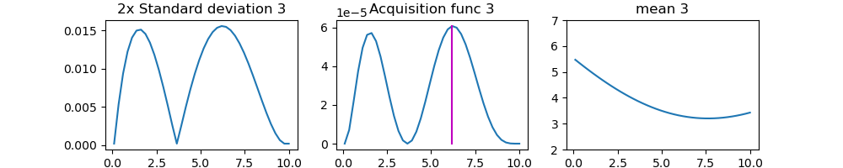
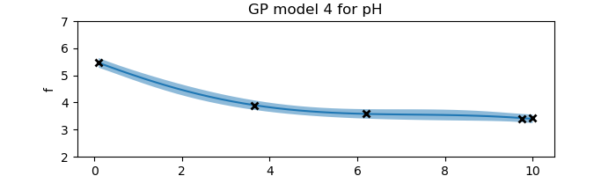
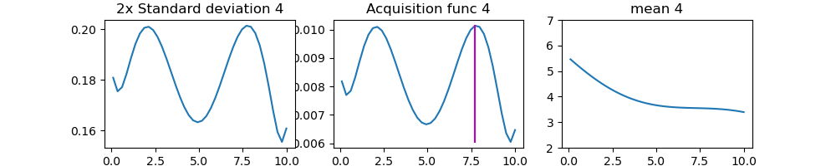
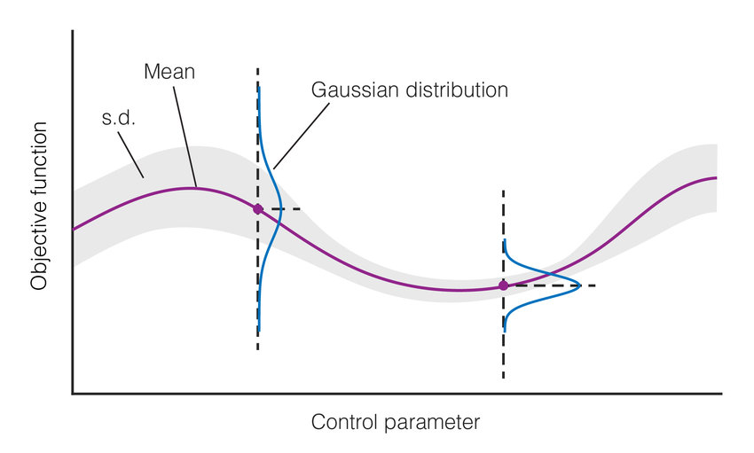
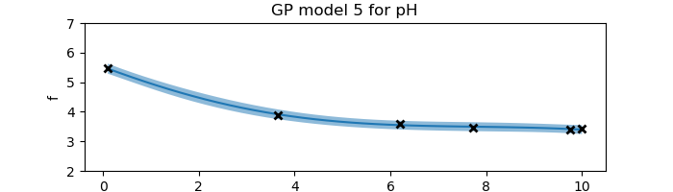
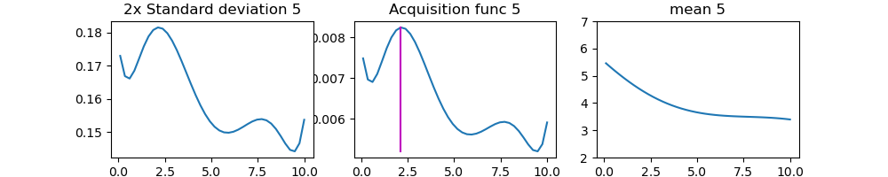
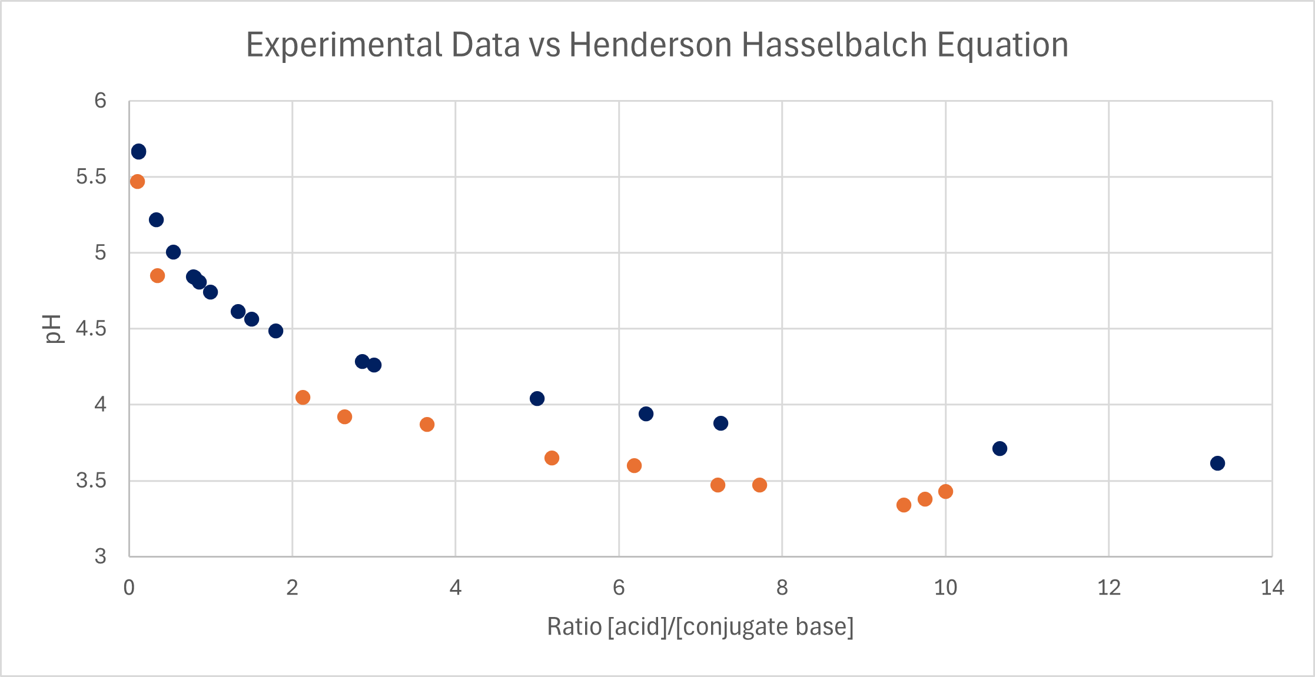
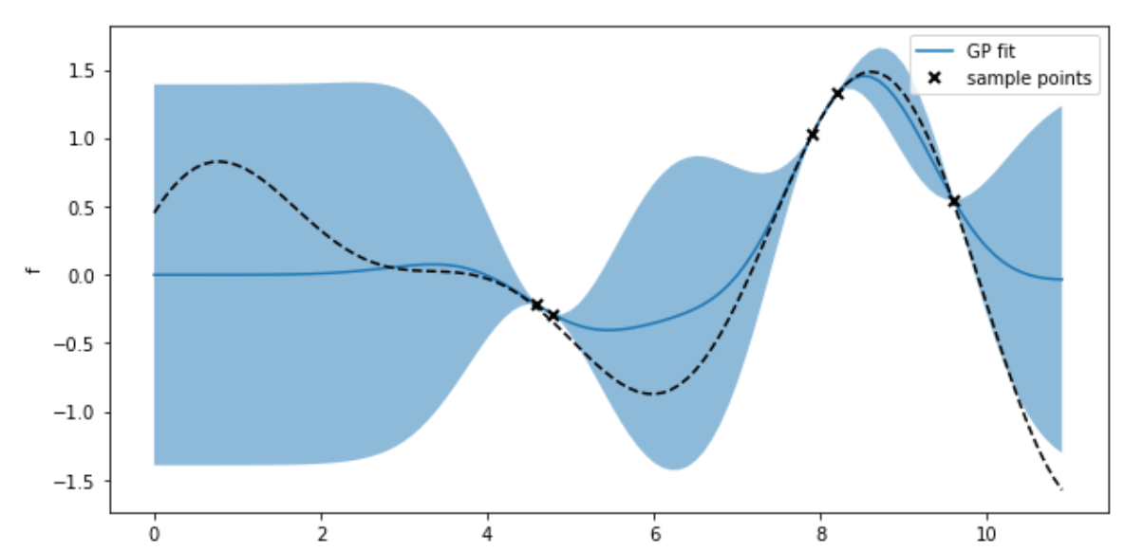
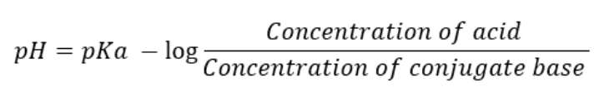
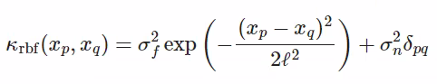
Automation and Machine Learning: How a Robot Can Conduct Its Own Experiments Using Gaussian Processes
Miller Gruen and Adi Timin
Advisor: Dr Mary Lowe, Physics Department, Loyola University Maryland
Introduction
Apparatus
Experimental Results
Computational Results
When scientists need to take large amounts of data, rather than taking countless measurements that take time, resources, and money, it may be better to automate the task. Beyond that, what if a device were able to do more than simply repeat a task, what if it could make its own decisions and conduct an experiment wholly without needing constant human supervision? We can accomplish this using Gaussian processes applied to machine learning. LEGOLAS is a device capable of applying these principals to
Legolas possesses:
2 Raspberry Pis
1 Arduino
6 Lego Motors
1 pipette
1 pH sensor
The Raspberry Pis connect wirelessly to a computer running the code and run the Lego motors using a build hat to connect.
Our goal is to discover the shape of the curve of the pH that results when mixing together an acid and a conjugate base.
We used Acetic Acid and Sodium Acetate.
We begin by taking a measurement at 0.1 ratio of the [acid]/[conjugate base].
From that, we obtain a measurement. With it, we obtain a curve with the uncertainty required to create an acquisition function.
From this, we obtain the next data point.
This continues until the curve is found.
Add your information, graphs and images to this section.
Theory and Background
Lego motor
Water
(rinsing)
Raspberry Pi and Build Hat
Application and Importance
Base
This experiment may be more akin to a proof of concept, however this principal is extremely valuable and can be applied to countless other disciplines. Being able to gain predictive power over any related variables’ inputs and outputs with minimal physical tests reduces costs when conducting research, in both resources and time. A device being able to apply these concepts on its own with minimal human interference frees researchers from tasks that take a lot of time and may be difficult for a human to do or calculate.
Acid
Limit switch
Standards
Experimental wells
The code is able to:
Establish communication between computer and pis
Functions for:
moving the motors in the x and y directions
Pipetting liquid
Moving pH sensor vertically
pH measurement
Cleaning and drying the pH sensor
GPy code
Function to establish RBF kernel
Function that does the regression
Function that uses active learning methods to determine the next data point to measure
Henderson Hasselbalch Equation
Acknowledgements
Add your information, graphs and images to this section.
Experimental data
References
Add your information, graphs and images to this section.

